Slide 1
Bayesian Network
Il-Chul Moon
Dept. of Industrial and Systems Engineering
KAIST
icmoon@kaist.ac.kr

Slide 2
Weekly Objectives
Know and memorize the theorems of probability
  Recover the probability concepts
  Recover the probability theorems
  Recover the concepts of the marginal and the conditional independencies
Understand Bayesian networks
  Know the syntax and the semantics of Bayesian networks
  Know how to factorize Bayesian networks
  Able to calculate a probability with given conditions
Understand the inference of Bayesian networks
  Able to calculate parameters of Bayesian networks
  Able to list the exact inference of Bayesian networks

Slide 3
Recap on Probability

Slide 4
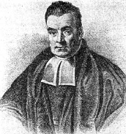
Probabilities
We will write P(A = true) to mean the probability that A = true.
What is probability?
  It is the relative frequency with which an outcome would be obtained if the process were repeated a large number of times under similar conditions*
The sum of the red and blue areas is 1
P(A = true)
*Ahem…there’s also the Bayesian definition which says probability is your degree of belief in an outcome
P(A = false)

Slide 5
Conditional Probability
P(A = true | B = true)
  Out of all the outcomes in which B is true, how many also have A equal to true
Read this as:
  “Probability of A conditioned on B” or “Probability of A given B”
H = “Have a headache”
F = “Coming down with Flu”
P(H = true) = 1/10
P(F = true) = 1/40
P(H = true | F = true) = 1/2
“Headaches are rare and flu is rarer, but if you’re coming down with flu there’s a 50-50 chance you’ll have a headache.”
P(F = true)
P(H = true)

Slide 6
Joint Probability
We will write P(A = true, B = true) to mean
  the probability of A = true and B = true
P(H=true|F=true)
P(F = true)
P(H = true)
In general, P(X|Y)=P(X,Y)/P(Y)

Slide 7
Computing with Probabilities:
Law of Total Probability
Law of Total Probability
  a.k.a “summing out” or marginalization
  P(a) = ∑_{b}P(a, b) = ∑_{b}P(a | b) P(b)
  When B is any random variable
Consider this case
  given a joint distribution (e.g., P(a,b,c,d))
  We can obtain any “marginal” probability (e.g., P(b)) by summing out the other variables
  P(b) = ∑_{a}∑_{c}∑_{d}P(a, b, c, d)
Also, consider this case
  given a joint distribution (e.g., P(a,b,c,d))
  We can obtain any conditional probability of interest
  P(c | b) = ∑_{a}∑_{d}P(a, c, d | b)=1/P(b)∑_{a}∑_{d}P(a, c, d, b)
  Where 1 / P(b) is just a normalization constant
Joint distribution contains the information we need to compute any probability of interest.

Slide 8
Computing with Probabilities:
Chain Rule or Factorization
We can always write
  P(a, b, c, … z) = P(a | b, c, …. z) P(b, c, … z)
  by definition of joint probability
Repeatedly applying this idea, we can write
  P(a, b, c, … z) = P(a | b, c, …. z) P(b | c,.. z) P(c| .. z)..P(z)
This factorization holds for any ordering of the variables
  Chain rule for probabilities
  Any joint probability → Can be factorized into a series of multiplication

Slide 9
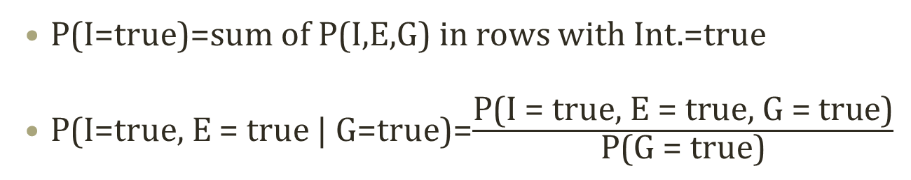
Joint Probability Distribution
Joint probabilities can be between any number of variables
  P(Int = true, Effort = true, GPA = true)
For each combination of variables, we need to say how probable that combination is
The probabilities of these combinations need to sum to 1
Int. | Effort | GPA | P(I,E,G)
false | false | false | 0.1
false | false | true | 0.2
false | true | false | 0.05
false | true | true | 0.05
true | false | false | 0.3
true | false | true | 0.1
true | true | false | 0.05
true | true | true | 0.15
P(I=true)=sum of P(I,E,G) in rows with Int.=true
P(I=true, E = true | G=true)=$\frac{\text{P}\text{(}\text{I}\text{ = }\text{true}\text{, }\text{E}\text{ = }\text{true}\text{, }\text{G}\text{ = }\text{true}\text{)}}{\text{P}\text{(}\text{G}\text{ = }\text{true}\text{)}}$
Sums to 1
Any problem in this statistical model?

Slide 10
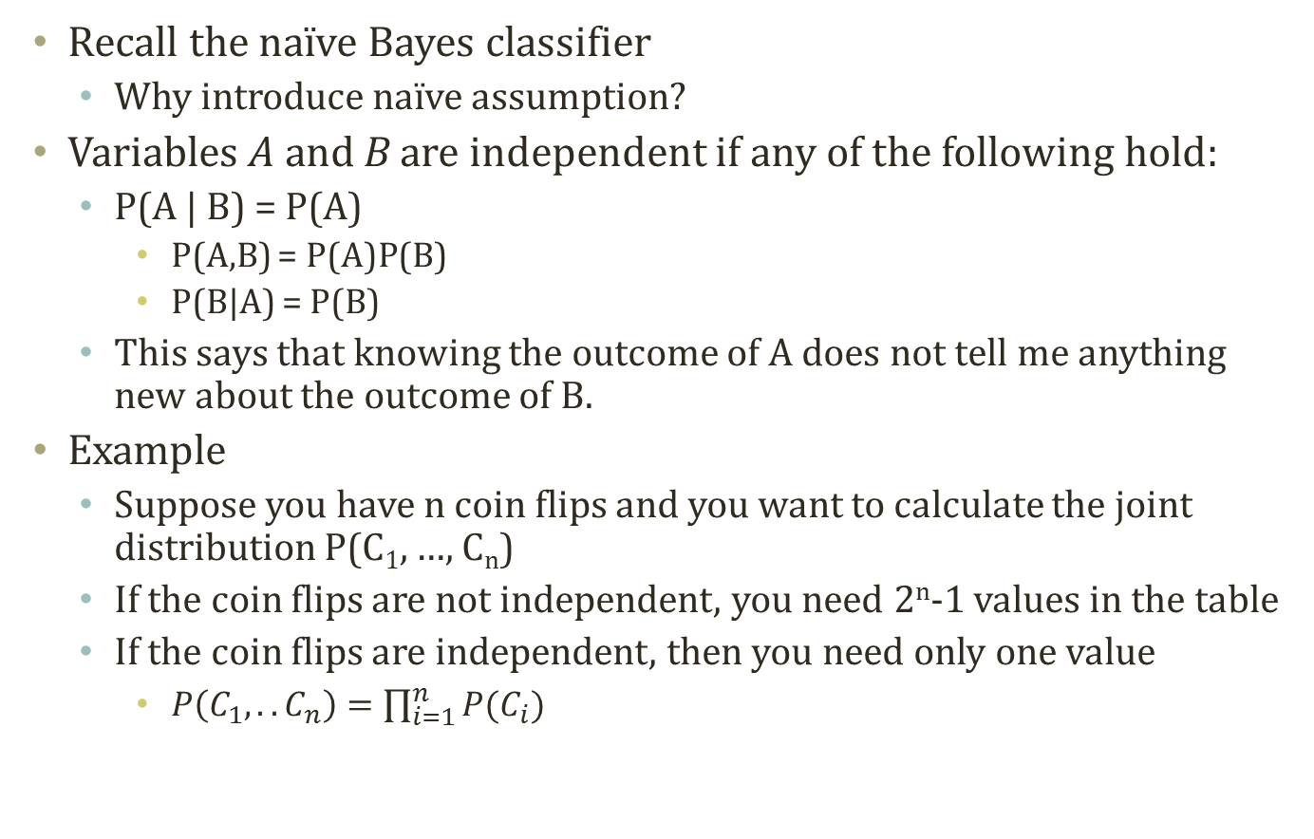
Independence
Recall the naïve Bayes classifier
  Why introduce naïve assumption?
Variables A and B are independent if any of the following hold:
  P(A | B) = P(A)
    P(A,B) = P(A)P(B)
    P(B|A) = P(B)
  This says that knowing the outcome of A does not tell me anything new about the outcome of B.
Example
  Suppose you have n coin flips and you want to calculate the joint distribution P(C₁, …, C_{n})
  If the coin flips are not independent, you need 2^{n}-1 values in the table
  If the coin flips are independent, then you need only one value
    $P\left(C_{1},..C_{n}\right)=\prod_{i=1}^{n}{P(C_{i})}$

Slide 11

Conditional vs. Marginal Independence
Go!
Go?
Commander
Go?
OfficerA
OfficerB
Marginal independence
  P(OfficerA=Go|OfficerB=Go) > P(OfficerA=Go)
  This is not marginally independent!
    X and Y are independent if and only if P(X)=P(X|Y)
    Consequently, P(X,Y)=P(X)P(Y)
Conditional independence
  P(OfficerA=Go|OfficerB=Go,Commander=Go)
  =P(OfficerA=Go|Commander=Go)
  This is conditionally independent!

